Slide 1
Desun Technology Pvt Ltd
Innovation | Technology | Solution
Crafting Digital Success Stories

Slide 2
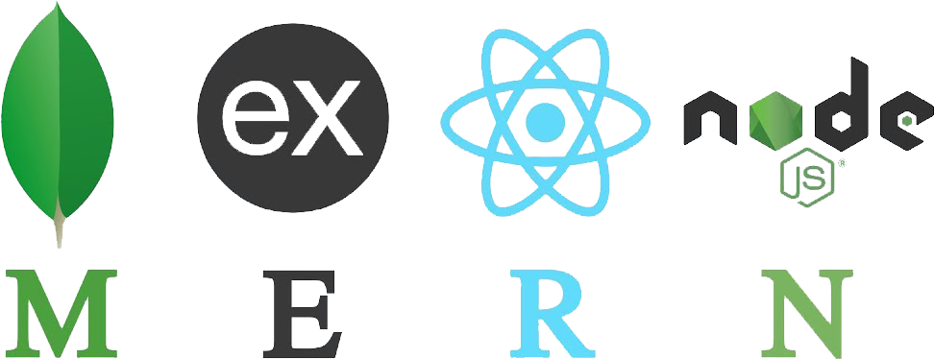

Slide 3
Welcome to the MERN Stack Workshop
Desun Technology Pvt Ltd
Instructor: Biswanath Nath (CTO)

Slide 4
Workshop Agenda
Introduction to the MERN Stack
Setting Up the Development Environment
Backend Development with Node.js and Express
Frontend Development with React
Connecting MongoDB to Express
Testing the Application
Q&A and Next Steps

Slide 5
Introduction to the MERN Stack
What is MERN Stack?
MERN stands for MongoDB, Express, React, and Node.js.
MongoDB: A NoSQL database for storing flexible, JSON-like documents.
Express.js: A web framework for Node.js that simplifies building servers and APIs.
React: A frontend library for building interactive UIs.
Node.js: JavaScript runtime that allows you to run JavaScript on the server side.
Key Points:
MERN allows for full-stack development with a single programming language: JavaScript.
Popular for building modern, dynamic web applications, including single-page applications (SPAs).

Slide 6
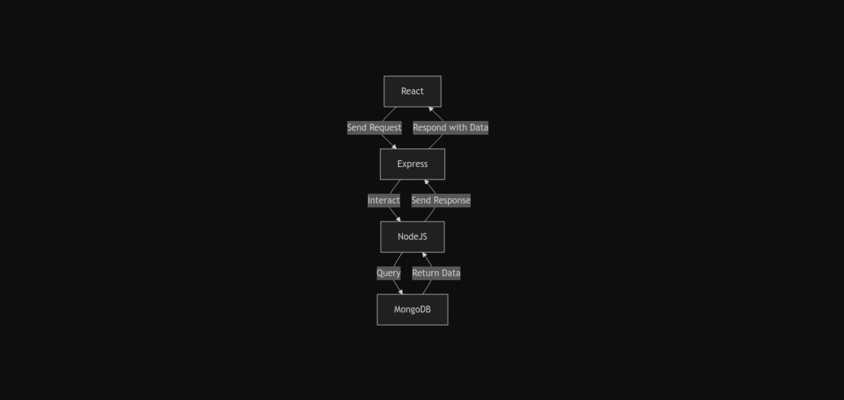
1. React (Frontend): The React app sends a request (e.g., API call) to the Express (Backend) server.
2. Express (Backend): The Express server is running on Node.js and handles requests, sending them to the MongoDB database.
3. Node.js (Server): Node.js processes the request, queries the MongoDB database, and retrieves the required data.
4. MongoDB: Stores and returns the requested data to Node.js.
5. The flow then reverses, where Node.js sends the data back to Express, and Express responds to the React frontend with the data.

Slide 7
Why MERN Stack?
Single Language: JavaScript across the entire application, making it easier for developers to learn and maintain. Streamlined development from client to server to database using one language.
Performance: React offers a fast, dynamic UI; MongoDB scales well for large datasets; Node.js handles many concurrent requests.
Developer Community: A large community with extensive documentation, libraries, and tutorials for each technology.
Key Points:
React’s virtual DOM makes it quick to update the UI dynamically.
MongoDB’s flexible schema allows for efficient data storage.
Node.js excels in handling I/O-bound operations and asynchronous programming.

Slide 8


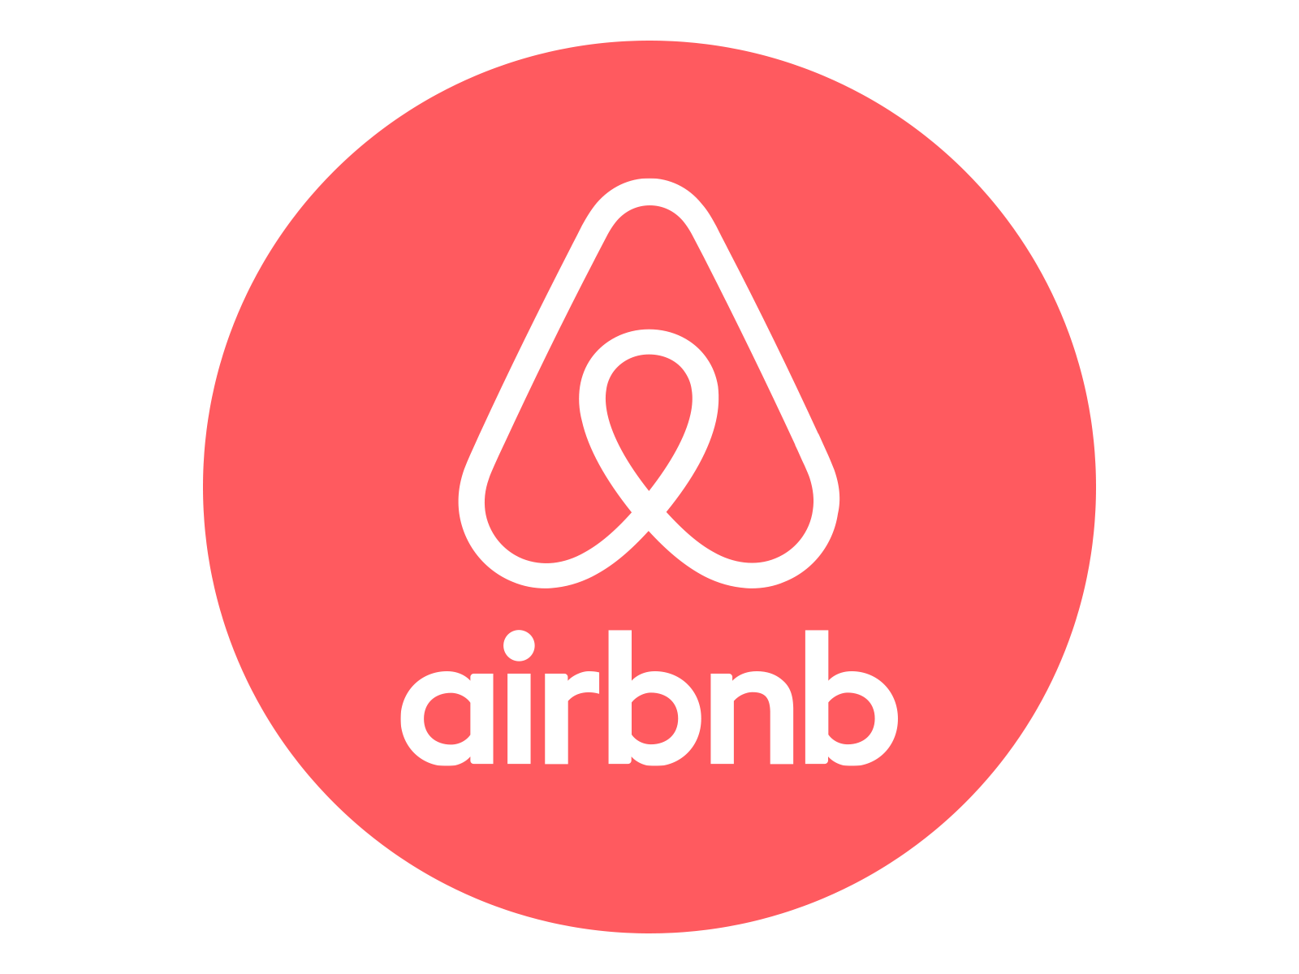
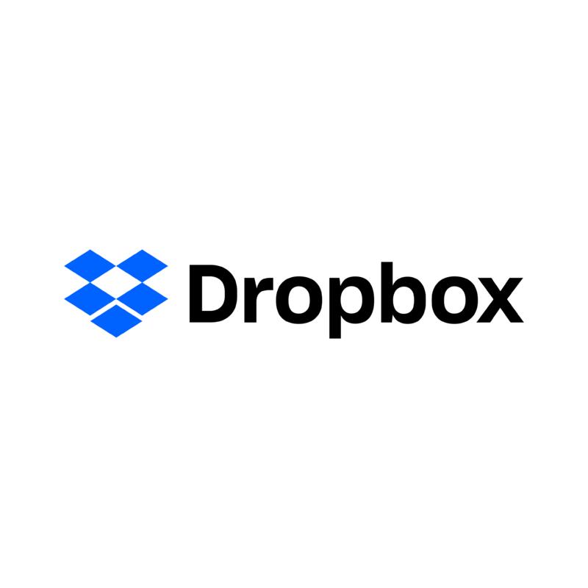

Real-World Applications

Slide 9

Setting Up the Development Environment
Node.js: Install Node.js and npm (Node package manager).
MongoDB: Install MongoDB locally or use MongoDB Atlas for cloud storage.
VS Code: Recommended code editor for working with JavaScript.
Postman: For testing REST APIs.
npm: Use npm init -y to create a Node.js project and install dependencies.
Steps:
Download Node.js: Go to nodejs.org, install Node.js, and verify the installation with node -v and npm -v.
Install MongoDB: Install MongoDB locally or create a free cloud cluster on MongoDB Atlas.
Set up Visual Studio Code: Use VS Code for writing and debugging JavaScript code.
Install Postman: Use Postman to test API requests during the backend development phase.

Slide 10
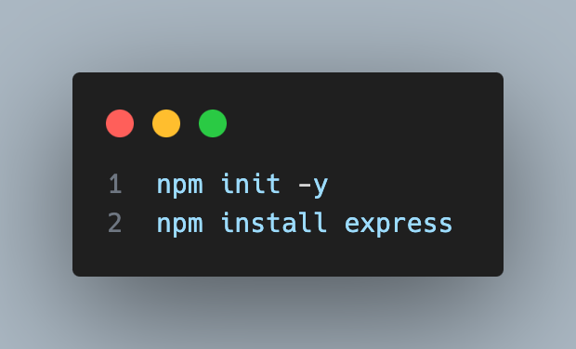
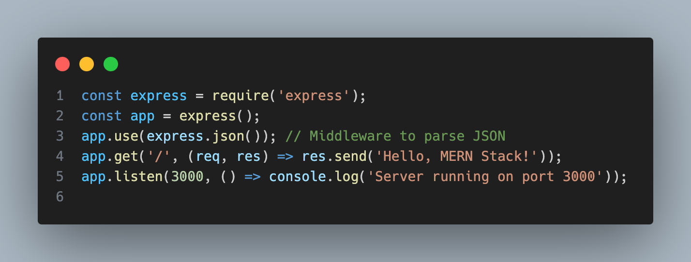
Creating a Simple Express Server
Step 1: Set up a new Node.js project using:
Step 2: Create a basic Express server to handle API requests:
Step 3: Run the server with node server.js and test it at http://localhost:3000.
Explanation: This code sets up a simple server that listens for requests on port 3000 and sends back a “Hello, MERN Stack!” message.

Slide 11


Working with MongoDB
1. The Client (React) sends a request (GET or POST) to the Server (Express.js)
2. The Server communicates with the MongoDB database to either retrieve or store data
3. MongoDB sends the requested data back to the Server
4. The Server then responds with the data, sending it back to the Client (React)

Slide 12
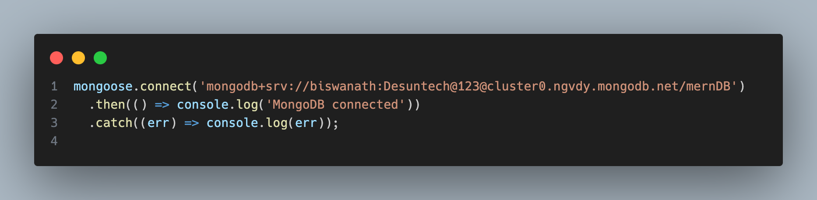
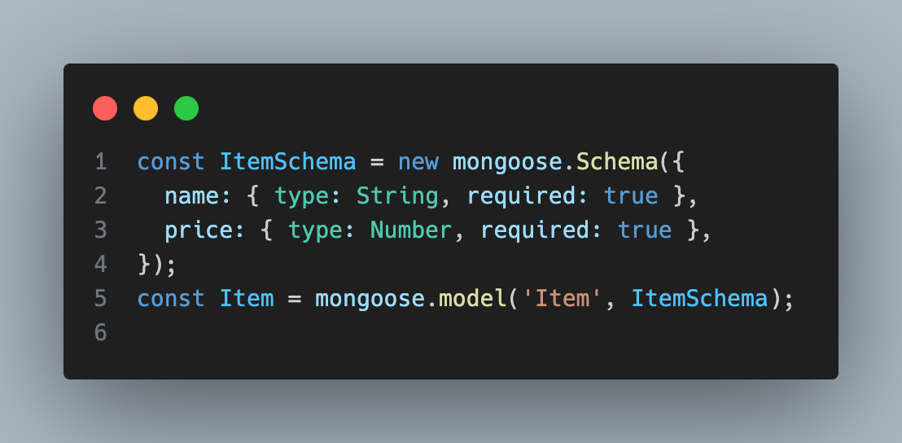
Working with MongoDB
Step 1: Connect to MongoDB using Mongoose:
Step 2: Define a schema and model for MongoDB:

Slide 13
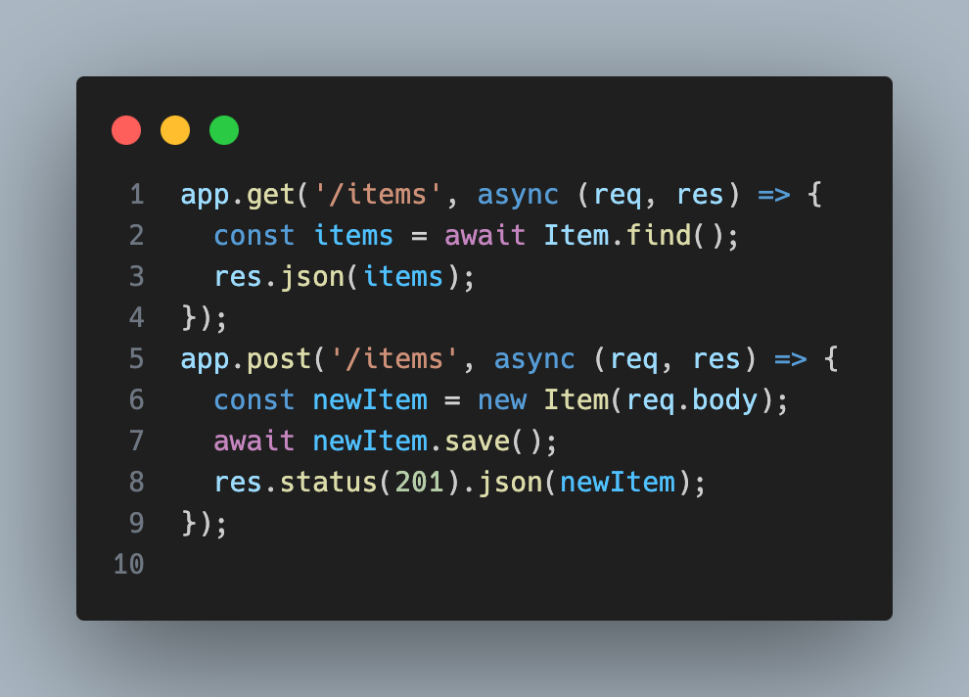
Working with MongoDB
Step 3: Create routes to handle GET and POST requests for items.

Slide 14
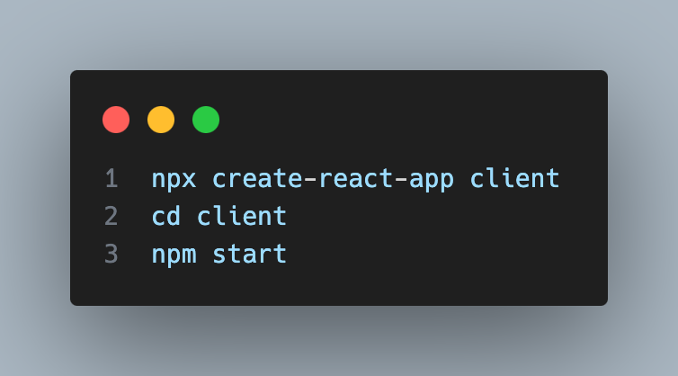
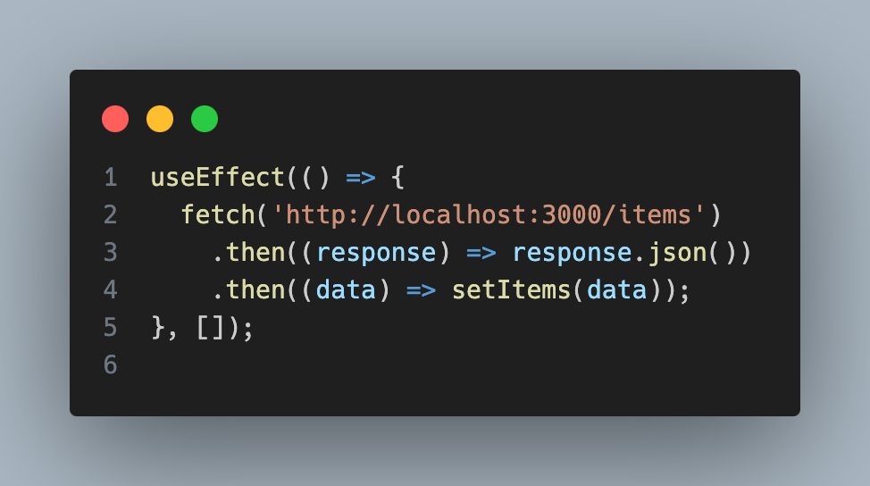
Building the Frontend with React
Step 1: Set up a React app using:
Step 2: Fetch data from the backend API:

Slide 15
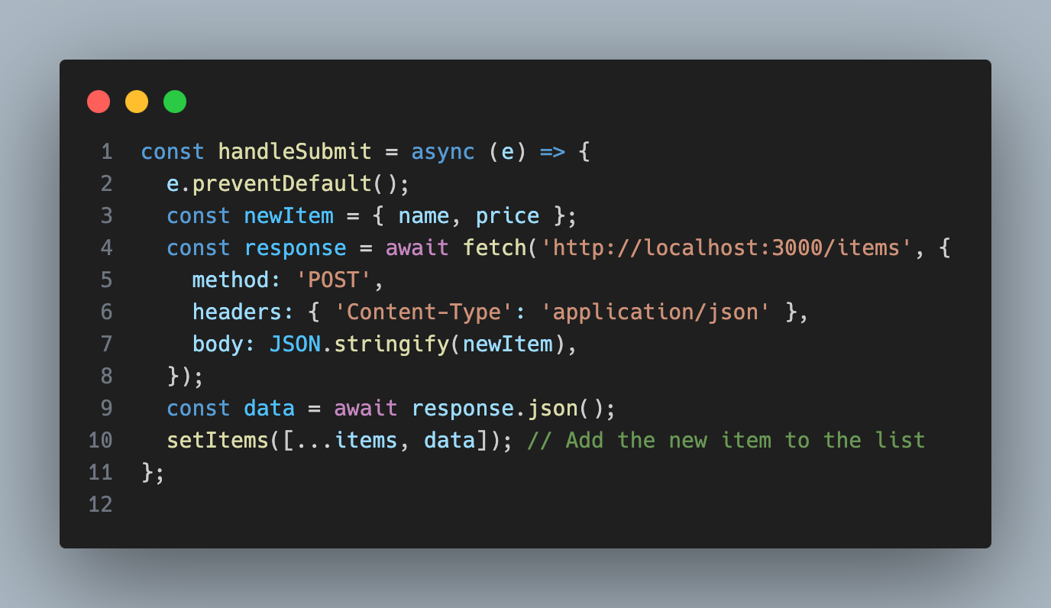
Building the Frontend with React
Step 3: Create a form to submit new items to the server:

Slide 16
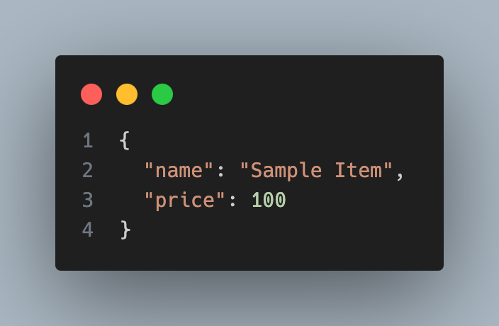
Testing the Application
Postman: Test the GET and POST API requests with Postman.
GET: Make a GET request to http://localhost:3000/items to see the list of items.
POST: Make a POST request with JSON data like:
Browser DevTools: Use the browser’s developer tools to inspect API calls and debug errors.

Slide 17
Wrap-Up and Next Steps
What You Learned:
1. Set up a Node.js and Express backend.
2. Connect the backend to a MongoDB database.
3. Build a React frontend and connect it to the backend.
4. Fetch and submit data using REST APIs.
Challenges for Further Learning:
1. Implement update and delete functionality (complete CRUD).
2. Add validation to the form (e.g., validate input fields).
3. Deploy the app (backend on Heroku, frontend on Netlify).

Slide 18
❝ The next big app could come from you! Think about the problems you face daily—how could you build an app to solve them? ❞

Slide 19
Q&A Session
Feel free to ask any questions about MERN Stack or general web development!

Slide 20
Connect With Us
Our Headquarters - Kolkata 81/2 Baghajatin Place, (Near Baghajatin Railway Station), Kolkata-700086, West Bengal, India
Email: desuntechnology@gmail.com , info@desuntechnology.in
Our City Office - Bangalore
Bangalore E2 Mims Espacio, Jakkur , GKVK Layout , Bangalore 560064, Near Sobha Emerald : Behind Jakkur Aerodrome PinCode: 560064

Slide 21
Thank You

